Slide 1
Computational Methods for Modeling Nonverbal Communication in Human Interaction
Rahul Gupta
Advisor: Dr. Shrikanth Narayanan

Slide 2
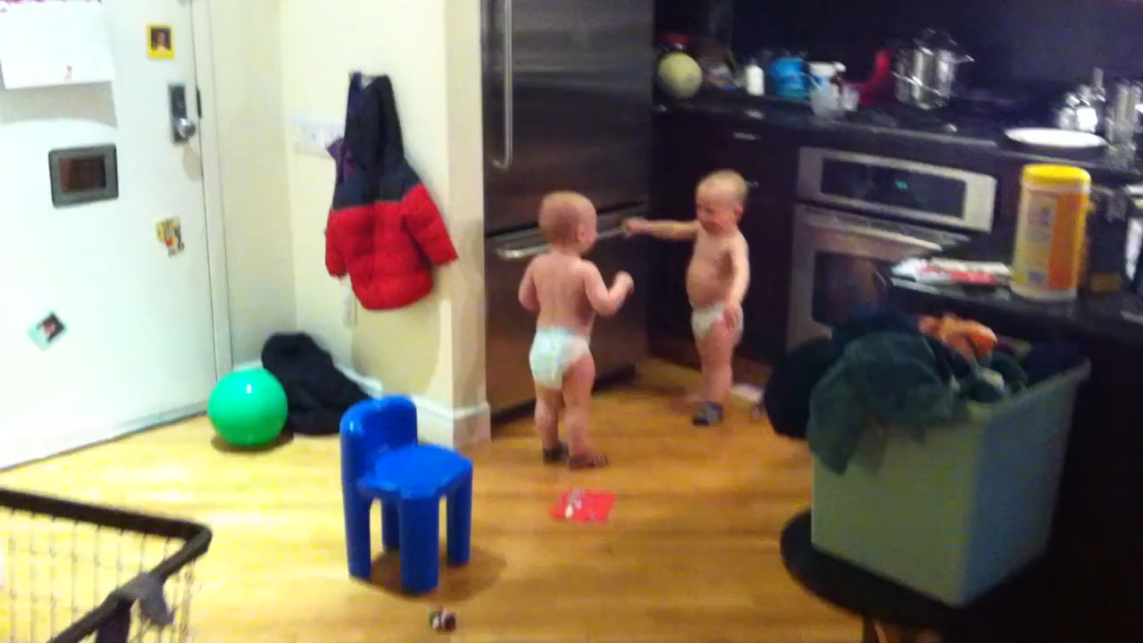
Nonverbal communication: Communication through sending and receiving wordless cues

Slide 3
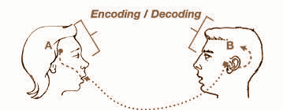
Nonverbal communication: Communication through sending and receiving wordless cues
Encoding: generation of nonverbal cues
Decoding: interpretation of nonverbal cues

Slide 4
Our contribution

Slide 5
Our contribution
Understanding the encoding

Slide 6
Our contribution
Detection of nonverbal cues

Slide 7
Our contribution
Modeling the decoding

Slide 8
Encoding

Slide 9

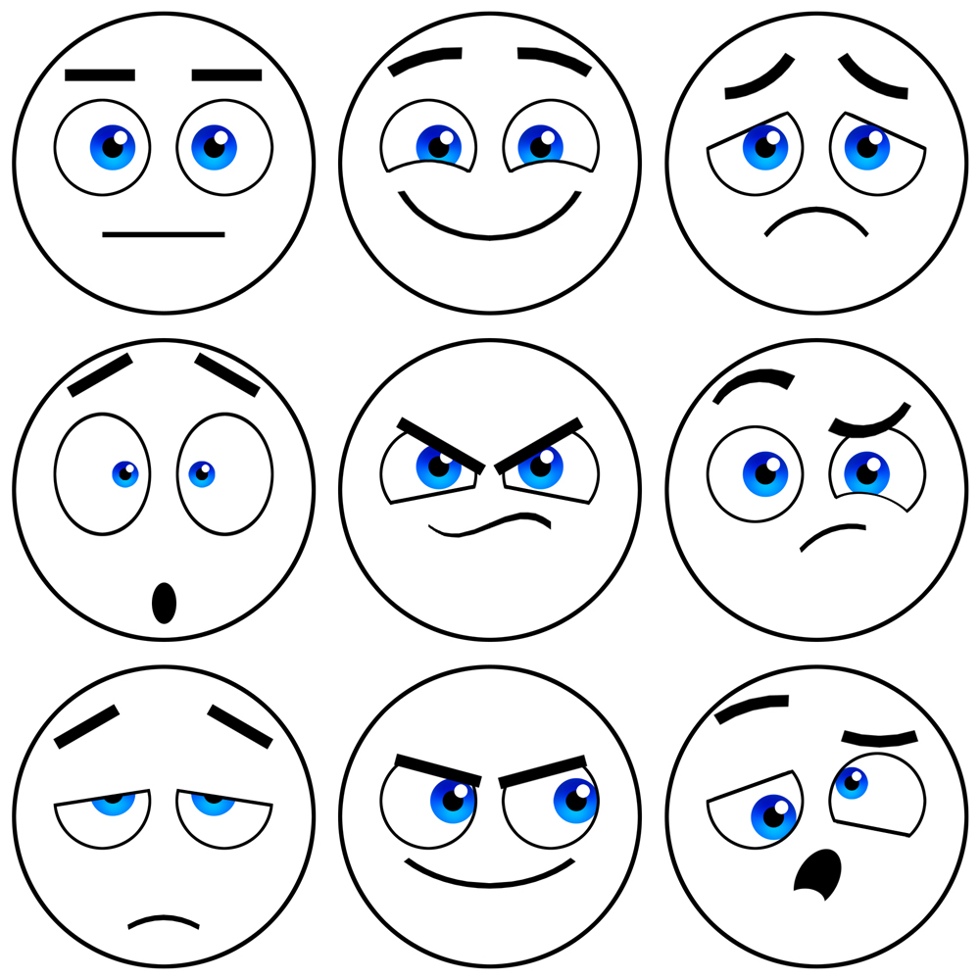


Encoding

Slide 10

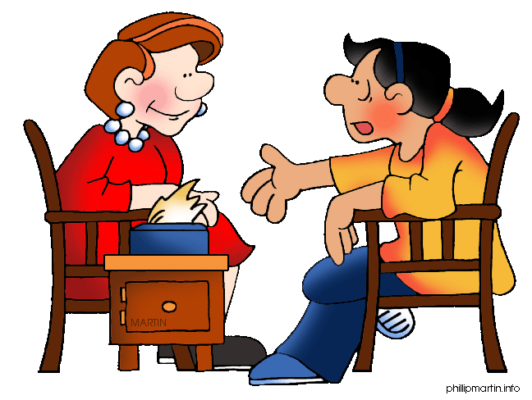
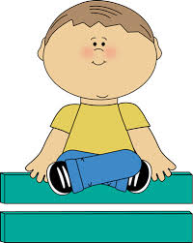


Encoding
Affect prediction in music using boosted ensemble of filters
Engagement prediction in psychologist child interactions
Modeling laughter behavior in motivational interviewing
Investigating relation between emotion and sighs
Multimodal prediction of affect

Slide 11
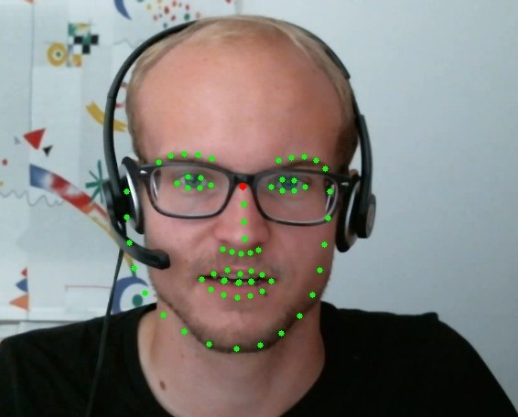
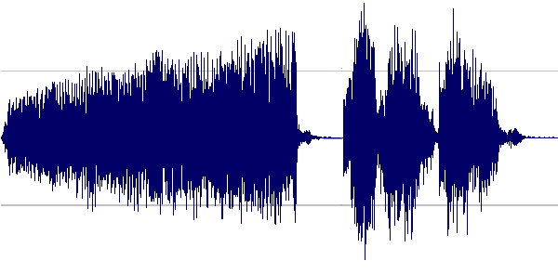
Encoding: Approach
Multimodal nonverbal cues

Slide 12

Encoding: Approach
Multimodal nonverbal cues
Incrementally building up models for interpretability

Slide 13
Detection

Slide 14
Detection
Performance driven design of models to maximize detection accuracy

Slide 15
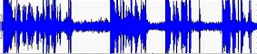

Detection
Detection of laughter and filler in audio stream
Detection of disfluencies in ASR transcripts
Is he involved um part of the group ?
Is he enrolled um part of the group ?
That’s
funny
ha ha ha

Slide 16
Detection: Approach
Signal stream
Target

Slide 17
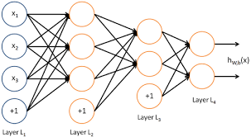
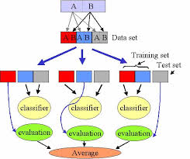
Detection: Approach
Strong classifiers
Signal stream
Target

Slide 18
Decoding

Slide 19
Decoding
Modeling diversity in perception of nonverbal cues

Slide 20
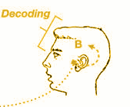
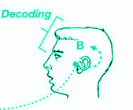
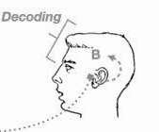
Decoding

Slide 21

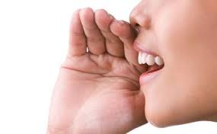

Decoding
Modeling ratings from multiple annotators on smile strength
Mixture of experts for assessing voice intelligibility
Inferring ranked lists from noisy pairwise comparisons

Slide 22
Decoding: Approach

Slide 23
Decoding: Approach
Observed signals from other person

Slide 24
Decoding: Approach
Observed signals from other person
“True” Latent state

Slide 25
Decoding: Approach
Observed signals from other person
“True” Latent state
Perception of receivers

Slide 26
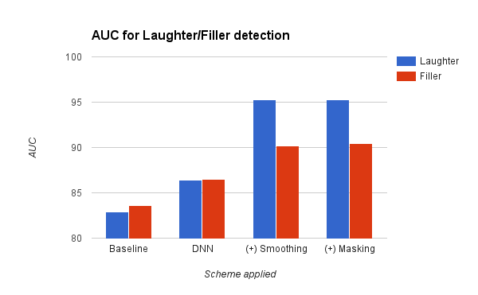
Results
> 90% AUC in prediction of nonverbal events (laughters and fillers)

Slide 27
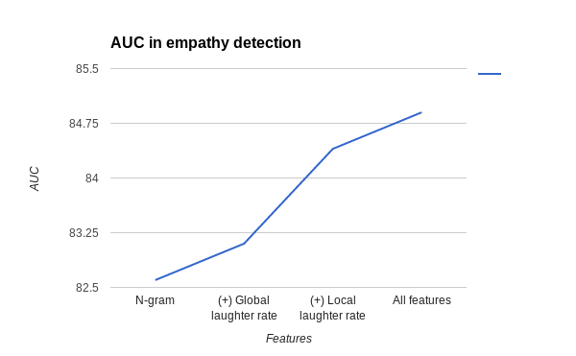
Results
Established relationship between empathetic response and laughter rates

Slide 28
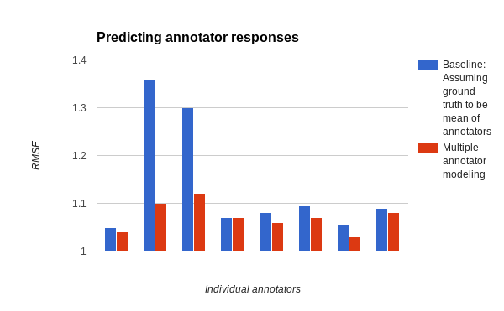
Results
Improved prediction of annotator responses in perception of smile strength

Slide 29
Conclusion
Understanding the encoding
Modeling the decoding
Detection of nonverbal cues

Slide 30
Thank you

